Slide 1
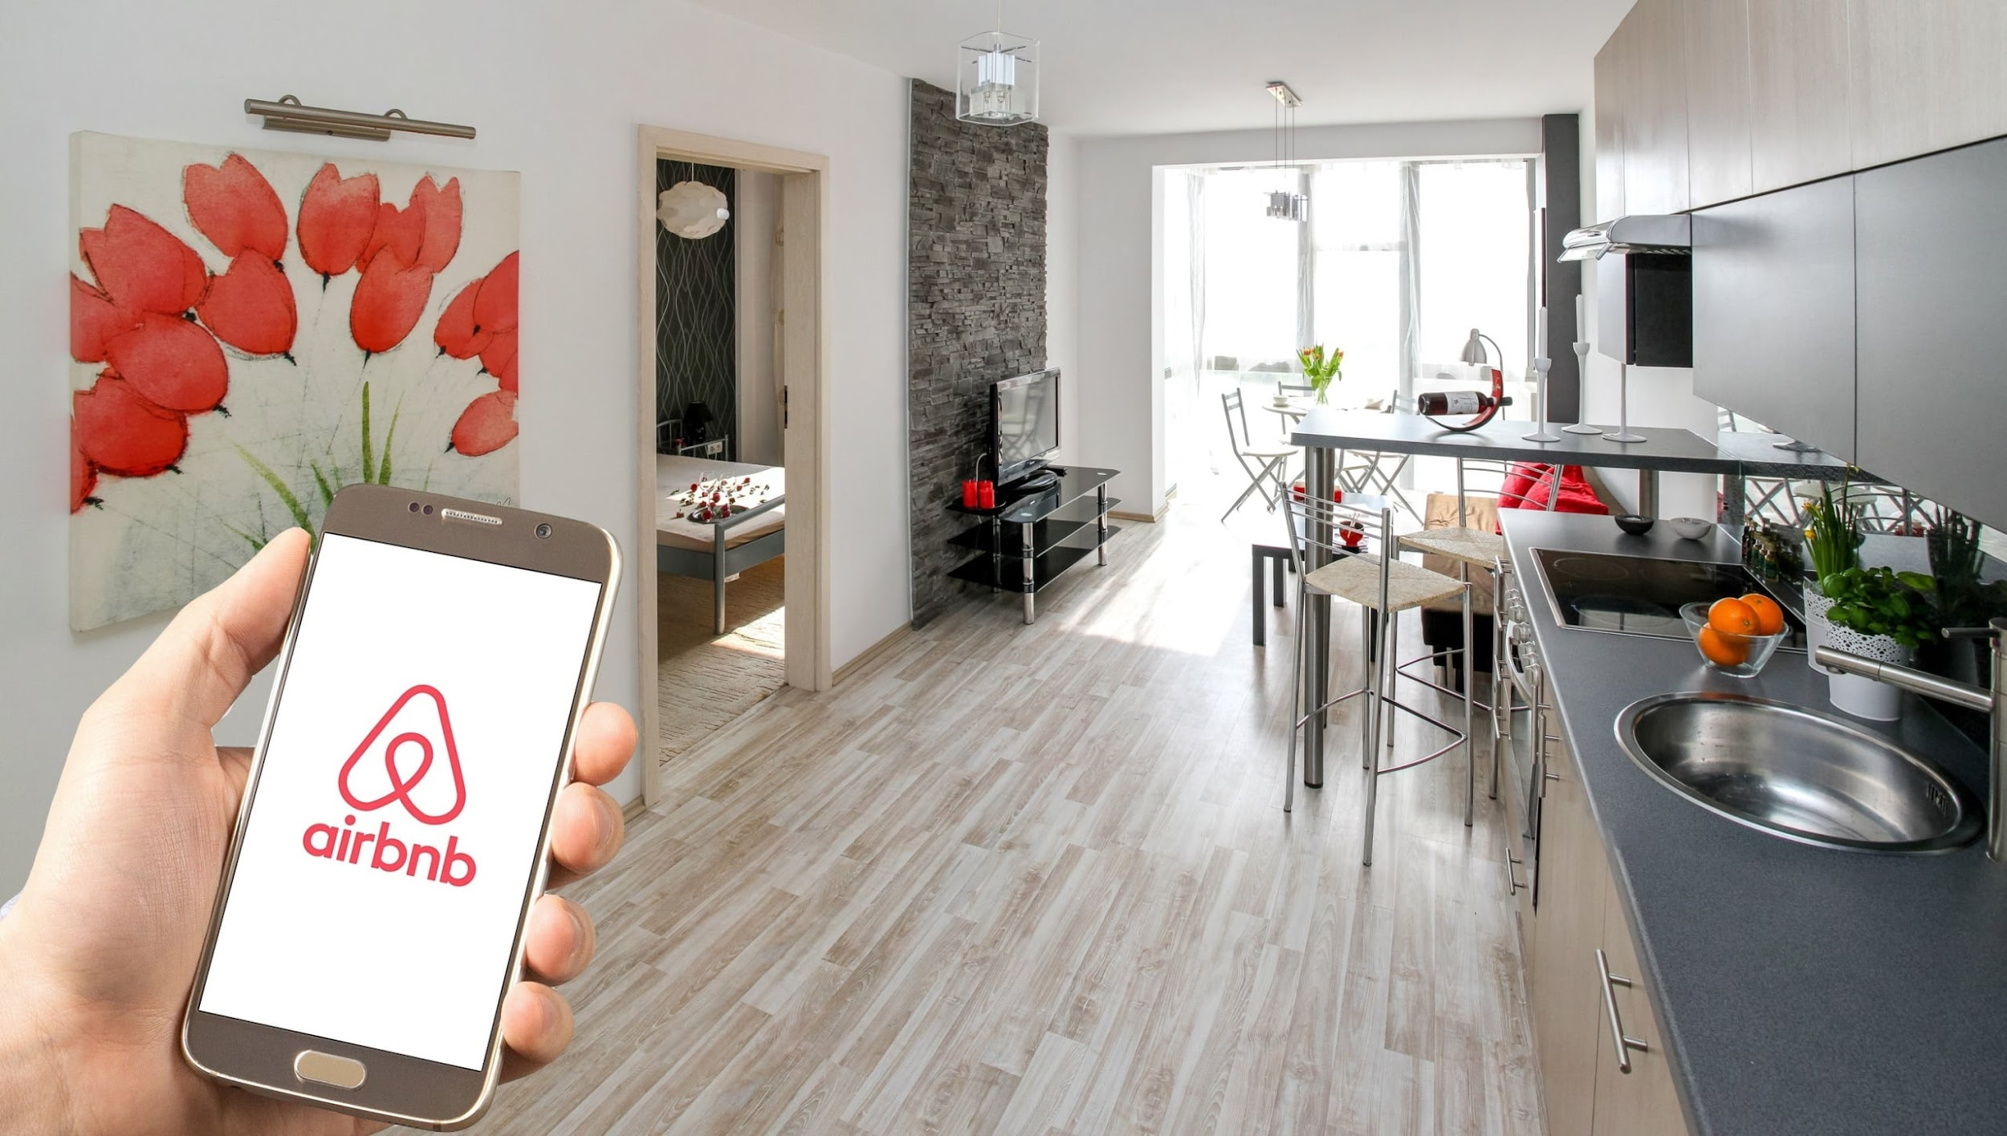
AirBnb stats:
Interest rate
Done by: Azamat Maraimbekov s22850
Abusat Aghali s21460
Khaing Pwint Wai Tun s23840
Abdelrahman Mobarak s22878

Slide 2

Goals of our project

Slide 3


Preparing the dataset
https://www.kaggle.com/datasets/thedevastator/airbnb-prices-in-european-cities
Interest Rate formula:
(cleanliness_rating*10*1.25 + guest_satisfaction_overall*1.5 + attr_index_norm*0.75 + rest_index_norm*0.5)/4 + 10/dist

Slide 4

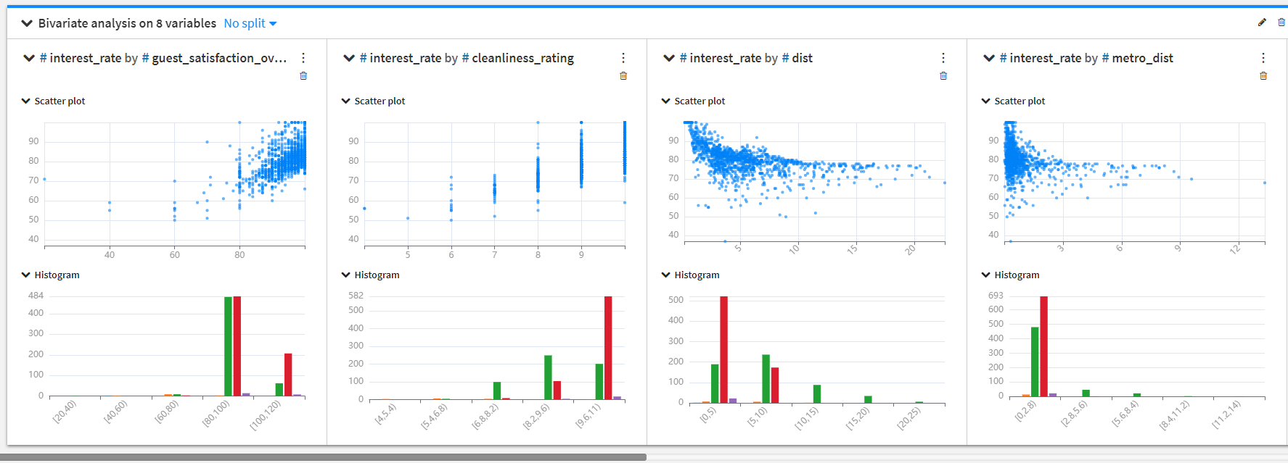
EDA

Slide 5

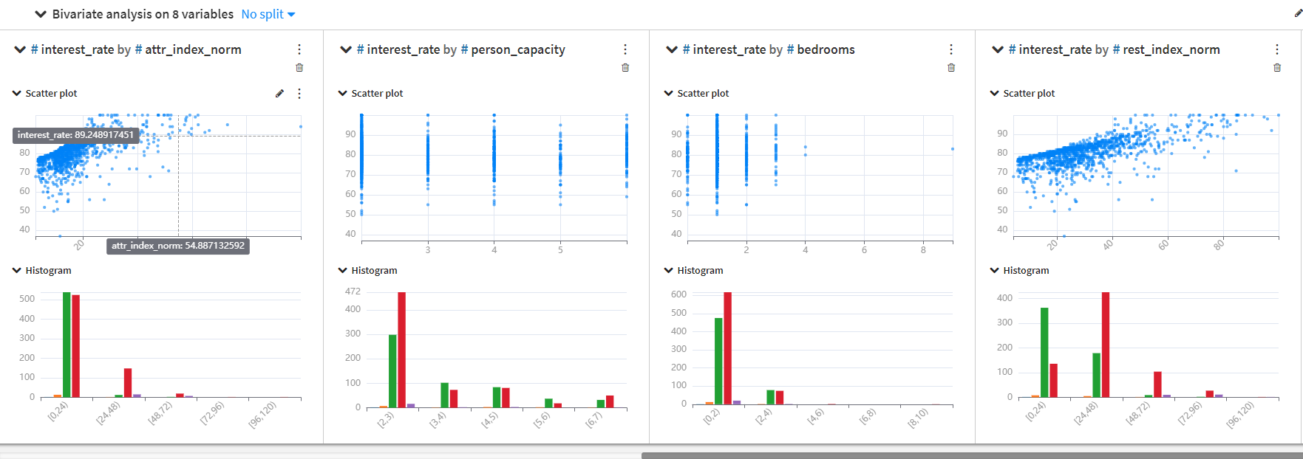

Slide 6

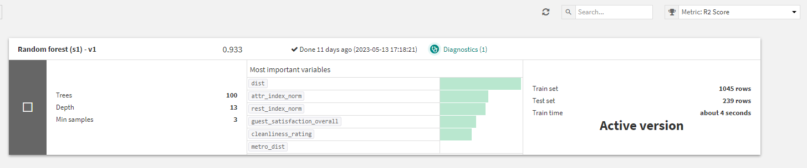
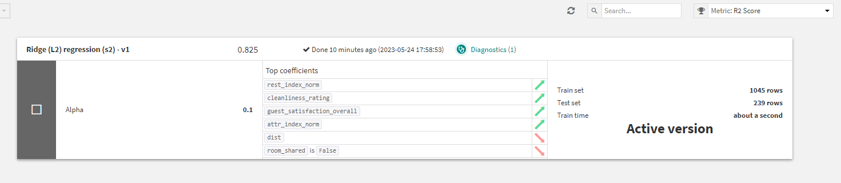
Prediction

Slide 7

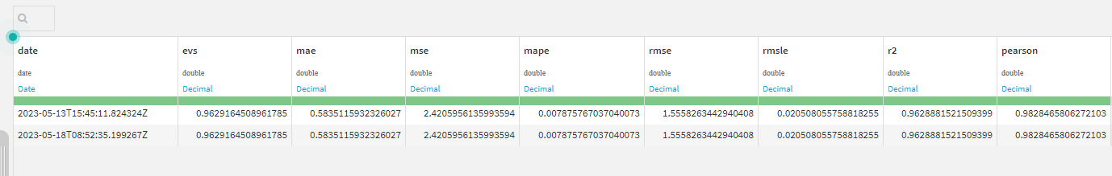
Success metric

Slide 8


